Slide 1



Readability
michel.grootjans@smallsteps.be
@michelgrootjans
michelgrootjans

Slide 2
An example
The librarian
Notes:
can climb up to high shelves
refused transformed back into a human
if someone ever reported that there was an orang-utan in the Library, the wizards would probably go and ask the Librarian if he'd seen it.
Being an ape, he is known for his violent reaction to most people calling him a "monkey." He speaks a language whose vocabulary consists primarily of the single word Ook (originally Oook), inflected for simple affirmations and negations. Eeek is also occasionally heard, particularly in moments of panic or rage. Nonetheless, most people seem able to understand him.

Slide 3
Ook
A programming language designed for orang-utans

Slide 4
Ook: design principles
A programming language should be writable and readable by orang-utans.
To this end, the syntax should be simple, easy to remember, and not mention the word "monkey".
Bananas are good.

Slide 5
Ook: Syntax elements
Ook.
Ook!
Ook?

Slide 6
Ook: Commands
Command | Symbol | Meaning
Ook. Ook? | > | increment the pointer
Ook? Ook. | < | decrement the pointer
Ook. Ook. | + | increment the integer at the pointer
Ook! Ook! | - | decrement the integer at the pointer
Ook! Ook. | . | output the ASCII character from the integer at the pointer
Ook. Ook! | , | input to the integer at the pointer (ASCII).
Ook! Ook? | [ | jump forward to the statement after the corresponding Ook? Ook! if the byte at the pointer is zero
Ook? Ook! | ] | jump back to the statement after the corresponding Ook! Ook? if the byte at the pointer is nonzero

Slide 7
Ook: Comments
Since the word "ook" can convey entire ideas, emotions, and abstract thoughts depending on the nuances of inflection, Ook! has no need of comments. The code itself serves perfectly well to describe in detail what it does and how it does it.
Provided you are an orang-utan.

Slide 8
Let’s see some code

Slide 9
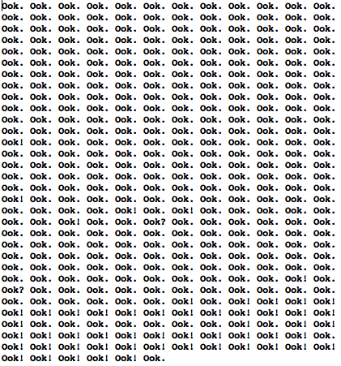
Guess what this code does

Slide 10
“Any monkey can write code that a computer can understand.
Good apes write code that an orang-utang can understand.”
-- The Librarian

Slide 11
Readability
Why?

Slide 12
Why?
It’s not about bits, bytes and protocols,
but profits, losses and margins.
-- Lou Gerstner
Notes:
Software should be designed to reduce its overall cost

Slide 13
Why?
cost_{total} | = | cost_{develop} + cost_{maintain}
cost_{maintain} | = | cost_{understand} + cost_{change} + cost_{test} + cost_{deploy}

Slide 14
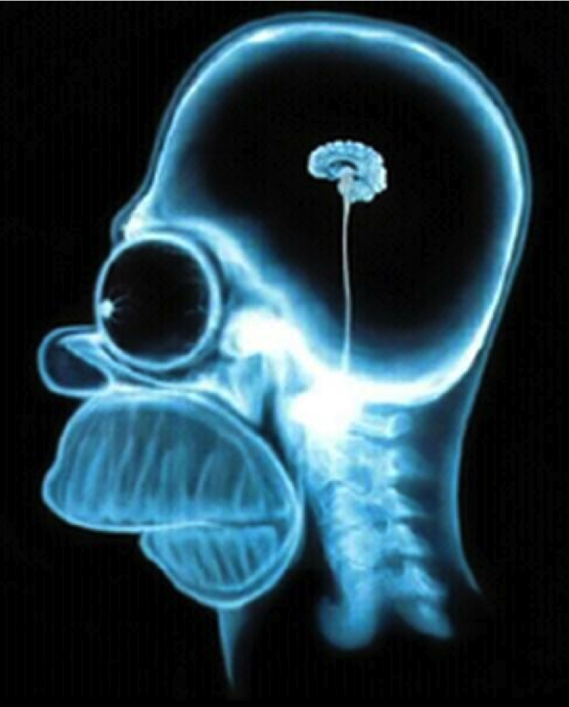
Why?
Easier to understand
=> Easier to change
=> Easier to test
=> Cheaper to maintain

Slide 15
In short
“There are two ways of constructing a software design.
One way is to make it so simple that there are obviously no deficiencies.
And the other way is to make it so complicated that there are no obvious deficiencies.”
-- C.A.R. Hoare

Slide 16
Readability
For whom?

Slide 17

Know your audience

Slide 18
Who are you writing code for?

Slide 19

The computer

Slide 20
Yourself
//Dear future me. Please forgive me.
//I can't even begin to express how sorry I am.
“Any code of your own that you haven’t looked at for six or more months might as well have been written by someone else.”
-- Eagleson’s Law

Slide 21
Other programmers
// no comments for you
// it was hard to write
// so it should be hard to read

Slide 22
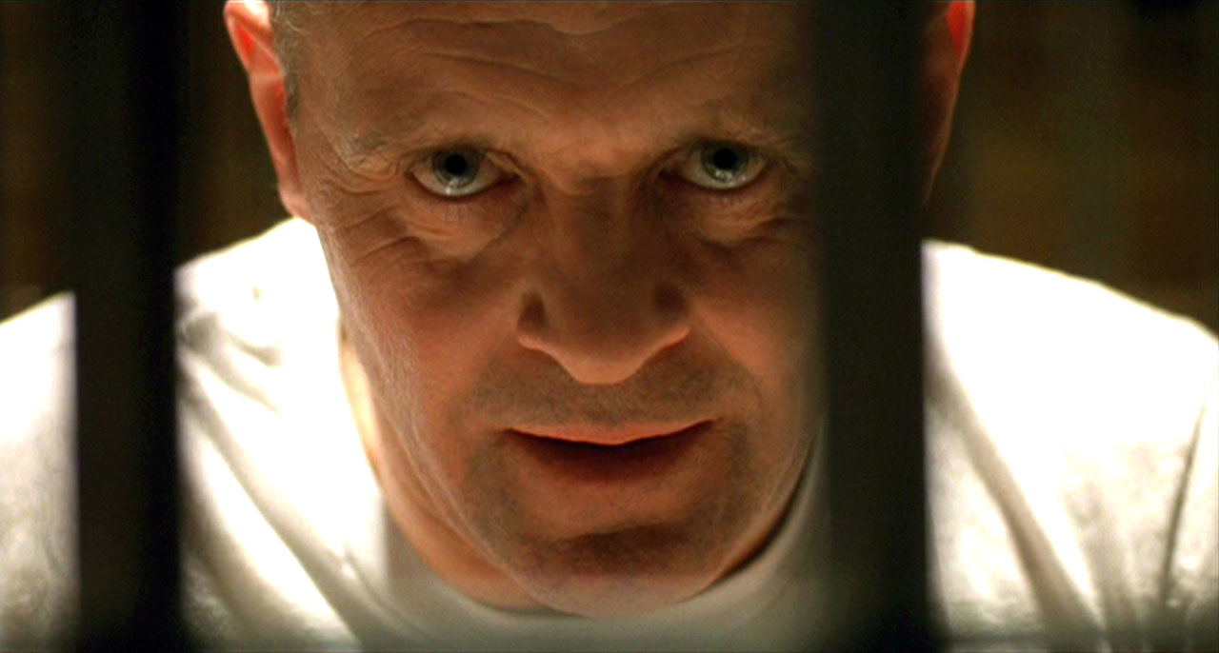
Other programmers
// I am not responsible of this code.
// They made me write it, against my will.
Always code as if the guy who ends up maintaining your code will be a violent psychopath who knows where you live
-- Martin Golding

Slide 23
Other programmers
//
// Dear maintainer:
//
// Once you are done trying to 'optimize' this routine,
// and have realized what a terrible mistake that was,
// please increment the following counter as a warning
// to the next guy:
//
// total_hours_wasted_here = 16
//

Slide 24

Your next boss

Slide 25
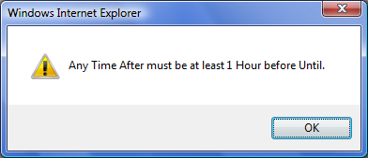
Your users

Slide 26
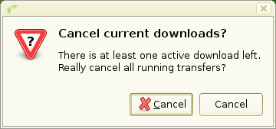
Your users

Slide 27
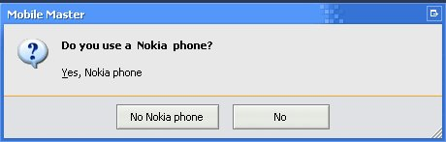
Your users

Slide 28
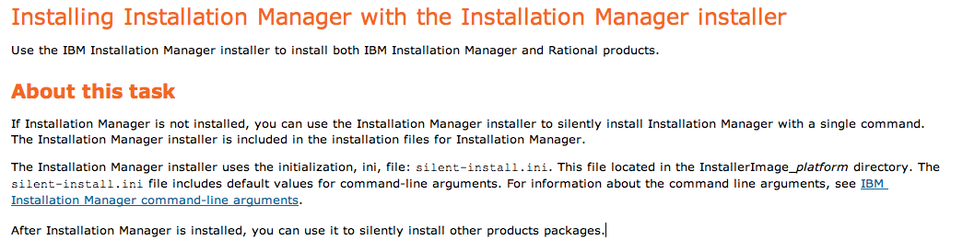
Your installers

Slide 29
Err...
//When I wrote this,
//only God and I understood what I was doing
//Now, God only knows

Slide 30
Readability
What not?

Slide 31
Bad code
Bad Code -- Bob Martin

Slide 32
What goes wrong with software?
Code ROTS
Notes:
The 2nd law of thermodynamics
The law of entropy

Slide 33
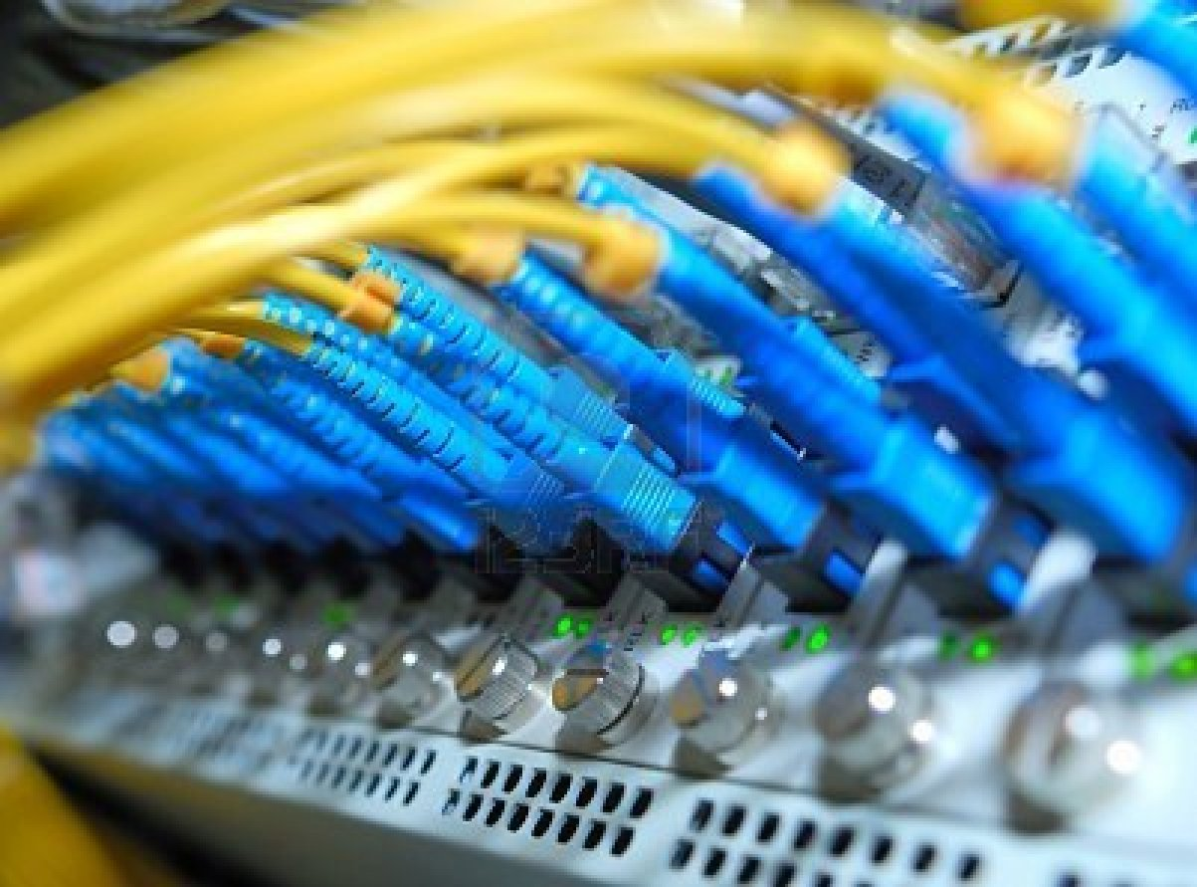
The first release

Slide 34
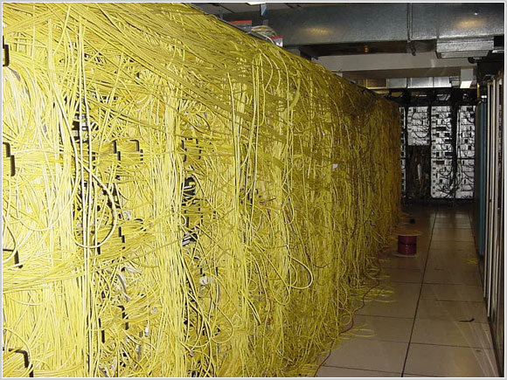
After 3 years of maintenance

Slide 35
Software today is very much like an Egyptian pyramid

Slide 36
Software today is very much like an Egyptian pyramid
with millions of bricks piled on top of each other,

Slide 37
Software today is very much like an Egyptian pyramid
with millions of bricks piled on top of each other,
with no structural integrity,

Slide 38
Software today is very much like an Egyptian pyramid
with millions of bricks piled on top of each other,
with no structural integrity,
but just done by brute force

Slide 39
Software today is very much like an Egyptian pyramid
with millions of bricks piled on top of each other,
with no structural integrity,
but just done by brute force
and thousands of slaves

Slide 40
Software today is very much like an Egyptian pyramid
with millions of bricks piled on top of each other,
with no structural integrity,
but just done by brute force
and thousands of slaves
-- Alan Kay

Slide 41
public string rom2num(string r)
{
if (r == "I") return "1";
if (r == "II") return "2";
if (r == "III") return "3";
if (r == "IV") return "4";
if (r == "V") return "5";
if (r == "VI") return "6";
if (r == "VII") return "7";
if (r == "VIII") return "8";
if (r == "IX") return "9";
//
// Snipped LOTS of "code" here
//
if (r == "MMVIII") return "2008";
if (r == "MMIX") return "2009";
if (r == "MMX") return "2010";
if (r == "MMXI") return "2011";
return "E";
}

Slide 42
$times = array(
"" => "",
"12:00:00" => "12:00 pm",
"12:30:00" => "12:30 pm",
"13:00:00" => "1:00 pm",
"13:30:00" => "1:30 pm",
"14:00:00" => "2:00 pm",
"14:30:00" => "2:30 pm",
"15:00:00" => "3:00 pm",
"15:30:00" => "3:30 pm",
"16:00:00" => "4:00 pm",
"16:30:00" => "4:30 pm",
"17:00:00" => "5:00 pm",
"17:30:00" => "5:30 pm",
"18:00:00" => "6:00 pm",
"18:30:00" => "6:30 pm",
"WY" => "Wyoming");

Slide 43
function doseq()
dim a, b, c, d
b = #11/4/2007 7:04:21 PM#
a = datediff("s", b, now)
a = a + 1194231874
doseq = a
end function
Notes:
returns the time since Unix epoch
gets the number of seconds from an epoch (not the Unix epoch)
adds a constant to successfully arrive at Unix time

Slide 44
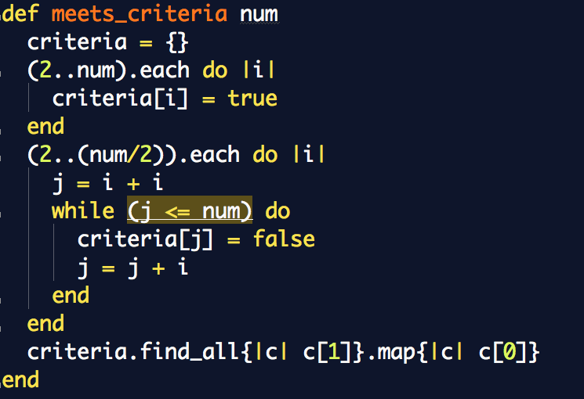

Slide 45
resources.reverse.drop(1).reverse.each { |resource| args[1] << resource }

Slide 46
Readability
What?

Slide 47
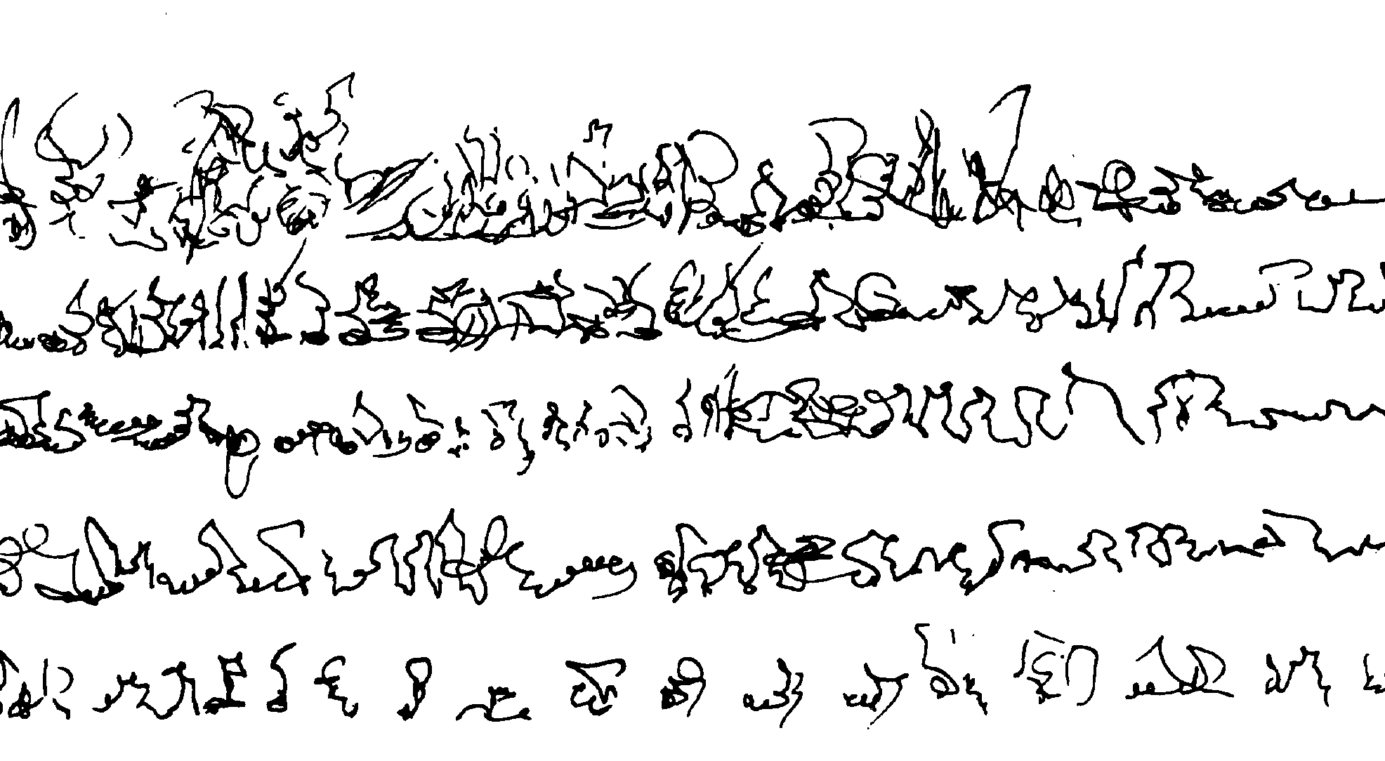
Legibility

Slide 48
Understandability
You need to know the technology

Slide 49
Understandability
You need to know the language
Synchronized interactive conglomeration
Right-sized static pricing structure
Cross-group intangible process improvement
Synergized flow catchments
Notes:
Legible
Understandable

Slide 50
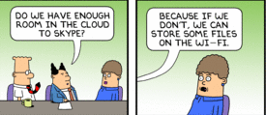
Understandability
The combination of words need to make sense
Notes:
Legible
Understandable

Slide 51
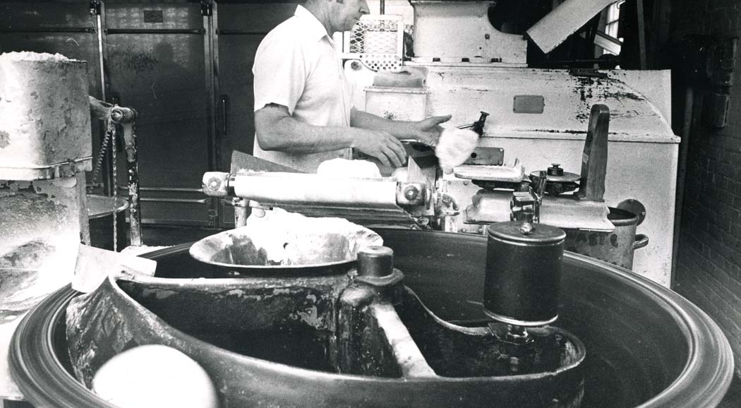
Clean
The bakery – Joel Spolski
Notes:
Is it always this messy?
Sides of the ovens yellowing
Rust on machines
Grease everywhere
It’s just been cleaned
Clean == no dough on the floor
Painting ovens every decade

Slide 52
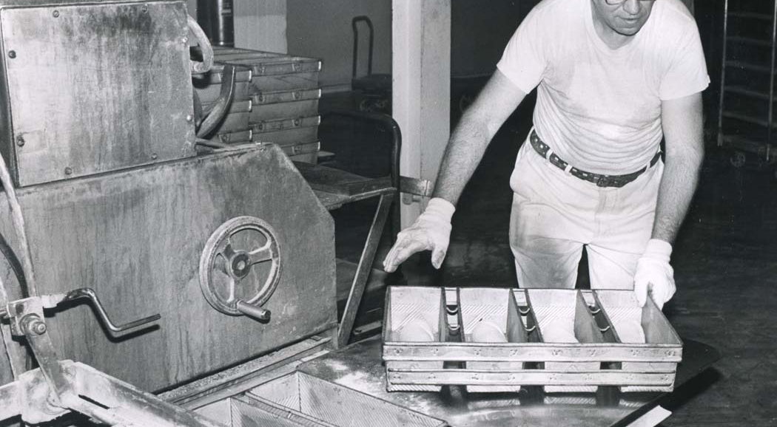
You have to learn what clean means

Slide 53
Readability
How?

Slide 54
Documentation
The palest ink is better than the best memory
-- Chinese proverb
Notes:
Just enough documenation
The same applies: keep the reader in mind

Slide 55
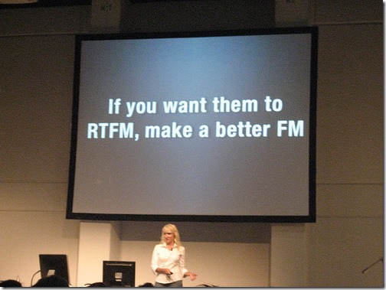

Slide 56
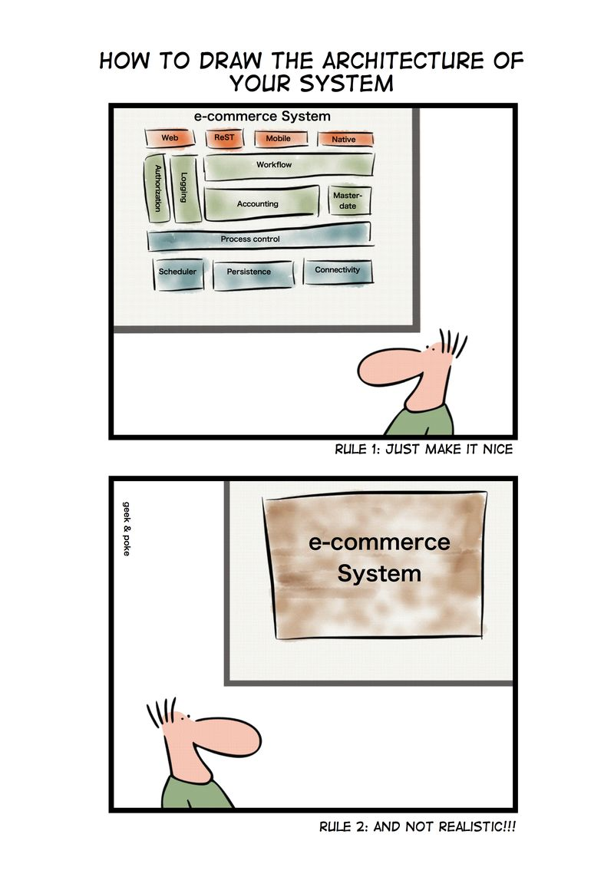
Documentation
Describe the environment

Slide 57
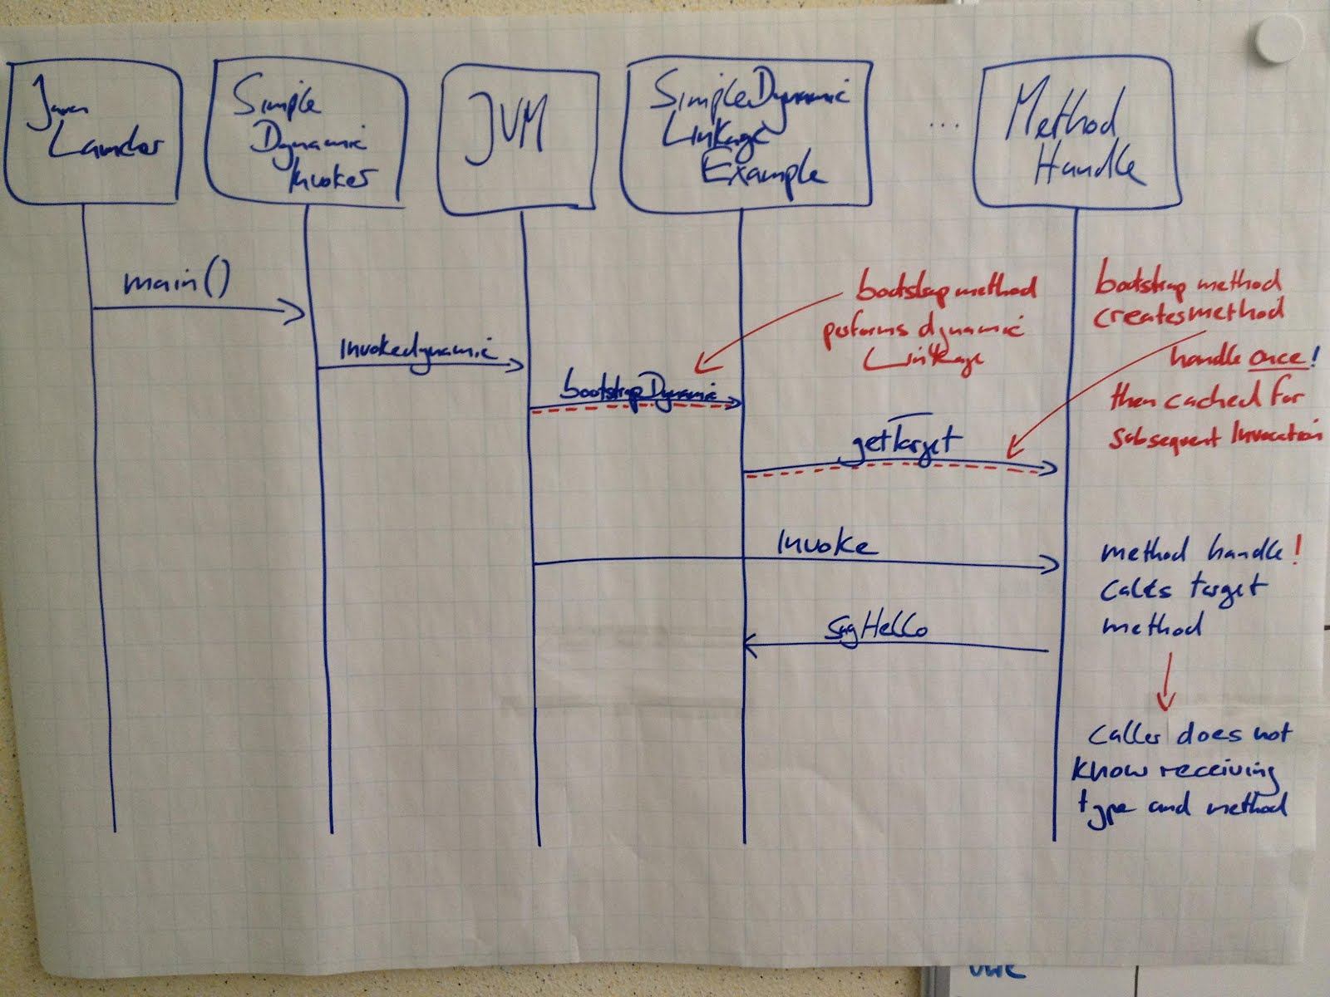
Documentation
Describe the design

Slide 58
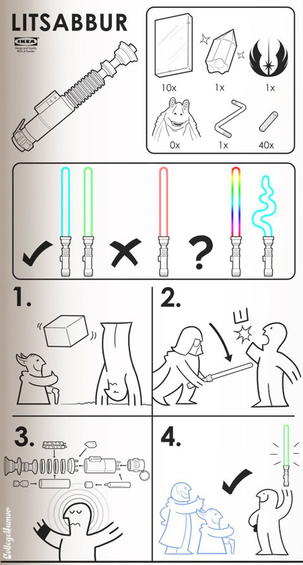
Documentation
Describe the steps needed to install

Slide 59
Comments

Slide 60
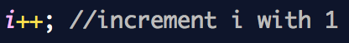
Comments
Commenting the obvious

Slide 61
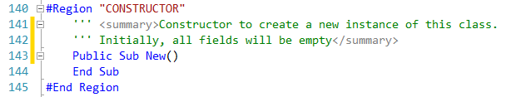
Comments
Commenting the obvious

Slide 62
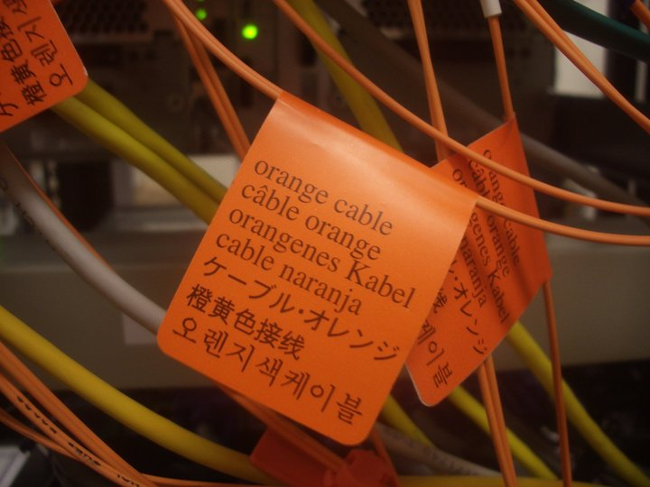
Comments
Commenting the obvious

Slide 63
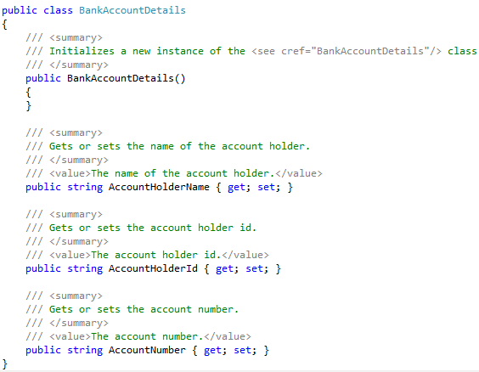
Comments
Commenting the obvious: There’s even a tool for that
Notes:
Violates DRY principle

Slide 64
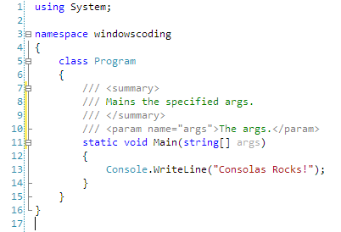
Comments
Commenting the obvious: There’s even a tool for that
Notes:
Violates DRY principle

Slide 65
Comment
Too many comments
/* Name: CopyString
Purpose: This routine copies a string from the source
string (source) to the target string (target)
Algorithm: It gets the length of "source" and then copies each character, one at a time, into "target". It uses
the loop index as an array index into both "source” and "target" and increments the loop/array index
after each character is copied.
Inputs: input The string to be copied
Outputs: output The string to receive the copy of "input"
Interface assumptions: none
Modification history: none
Author: Dwight K. Coder
Date Created: 10/01/04
Phone: (555) 222-2255
SSN: 111-22-3333
Eye color: green
Maiden name: none
Blood type: AB-
Mother's Maiden Name: Bartlett
Favorite car: Pontiac Aztec
License Plate: "Tek-ie"
*/
public void copyString(String s1, String s2){
...

Slide 66
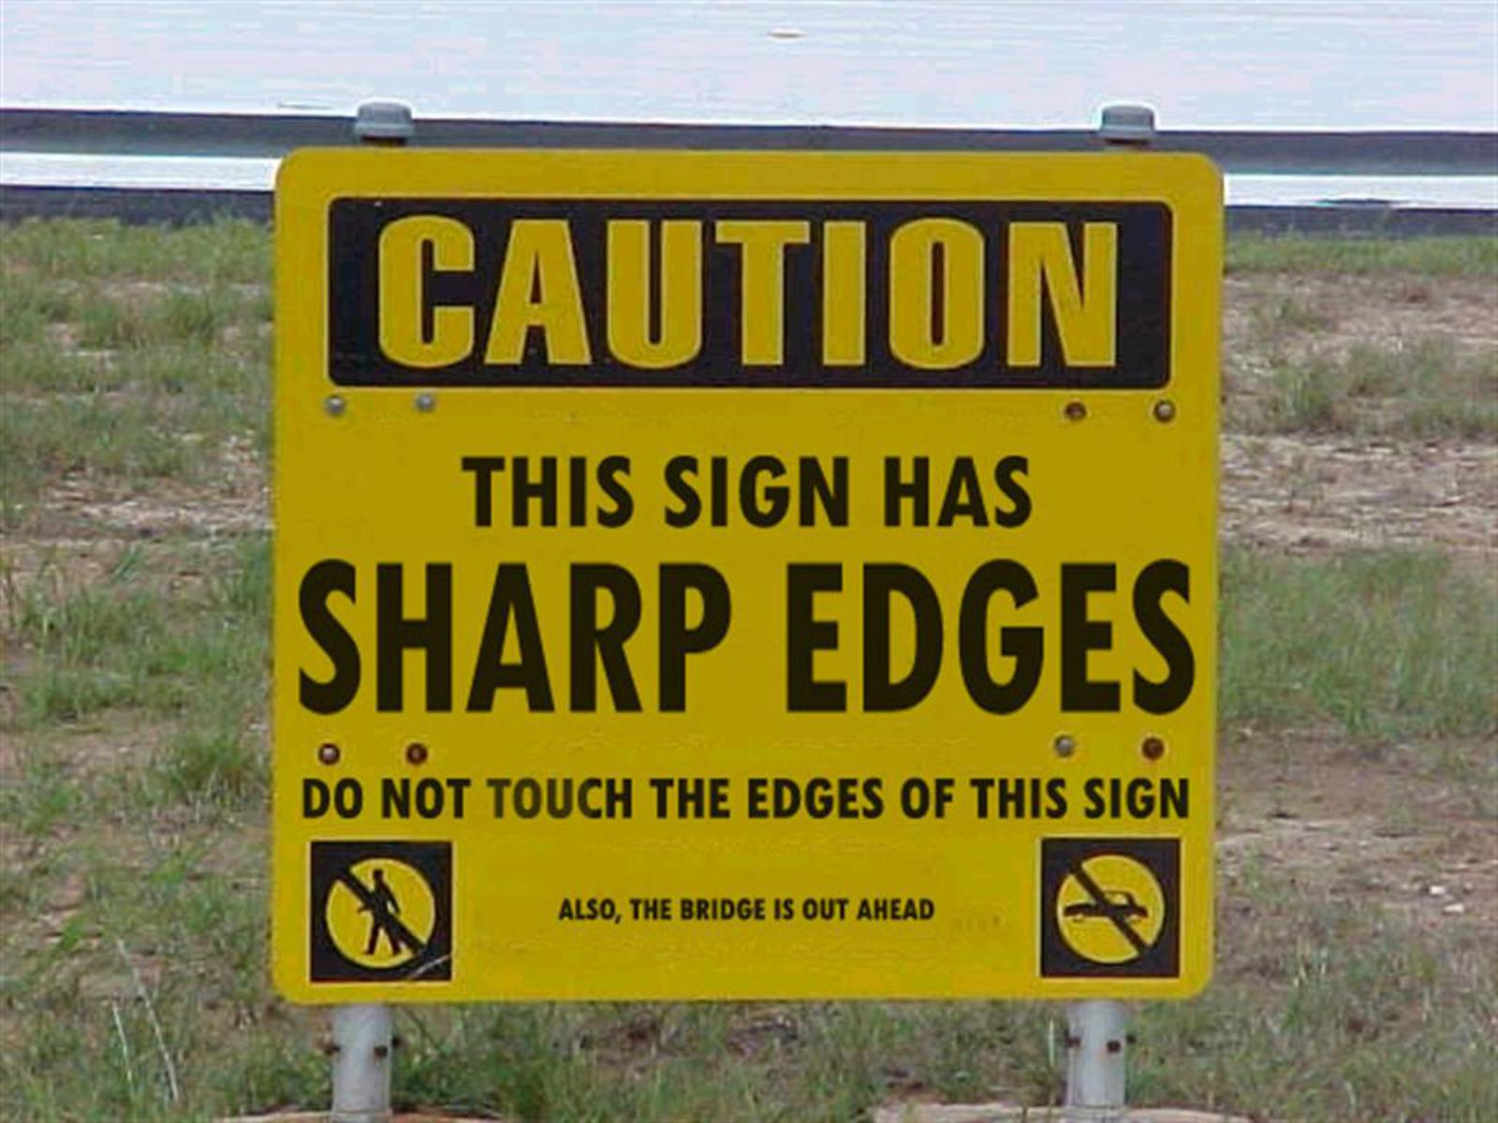
Comment
Too many comments

Slide 67
Readability
Practices

Slide 68
Code conventions
Notes:
Braces
Camel/Pascal/underscore
No holy wars
Choose 1 convention, then stick with it

Slide 69
Use the business language
Notes:
Avoid mental mapping

Slide 70
TDD
Wishful programming
Your tests have to be readable too

Slide 71
Refactoring
Make it correct
Make it clear
Make it concise
Make it fast

Slide 72
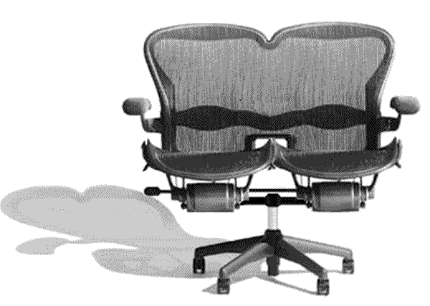
Have reviews
Formal
Informal
Pairing

Slide 73
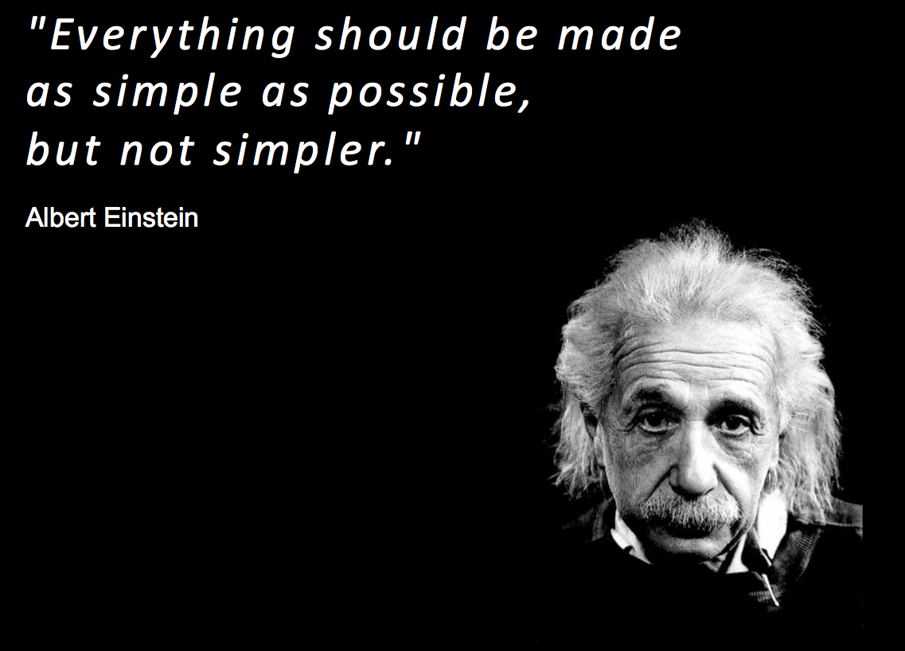
Simplicity
Notes:
No clever tricks
“Debugging is twice as hard as writing the code in the first place. Therefore, if you write the code as cleverly as possible, you are–by definition–not smart enough to debug it.”
(Brian Kernighan)

Slide 74
Rules of simple design
All tests pass
Intent revealing
No duplication
Small

Slide 75
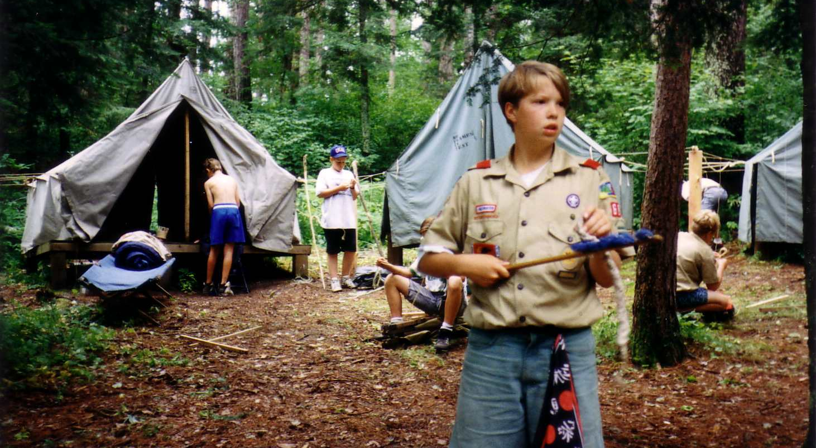
The boy scout principle
Notes:
Random acts of kindness in the code you encounter

Slide 76
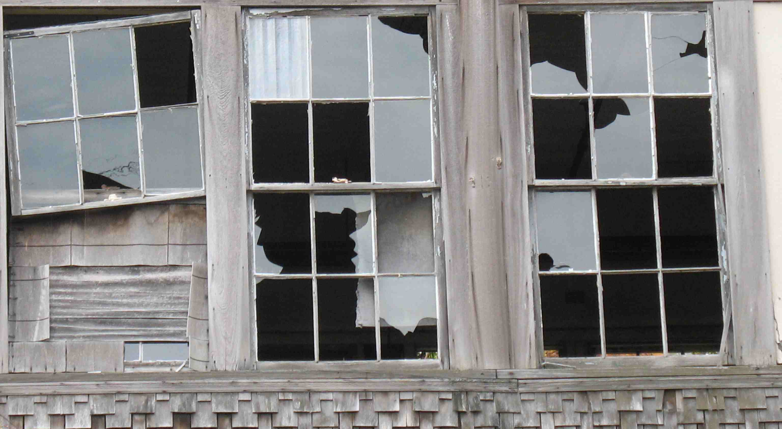
Don’t live with broken windows
Notes:
2nd law of thermodynamics: the law of entropy

Slide 77
Readability
Techniques

Slide 78
Typing is not the bottleneck
Writing code is the easy part
Code is read 10 times more than it is written

Slide 79
Blank lines
Add blank lines to separate paragraphs of code

Slide 80
Indentation
Indent logically
Try one indentation per method

Slide 81
Choose good names
SomethingManager
SomethingService
SomethingComponent
Notes:
Call them Buckets, Superviser, Dispatcher, ...
Managers do too much
There are only 2 things difficult in IT

Slide 82
Demeter
Just 1 dot per line
HttpContext.Current.User.Identity.Name.ToString();

Slide 83
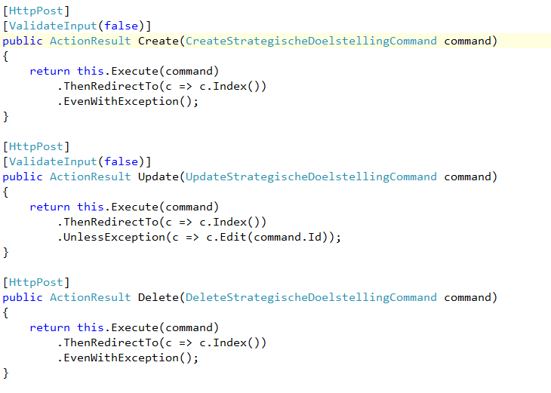
Focus on the outcome

Slide 84
Command-Query separation

Slide 85
Let’s code

Slide 86
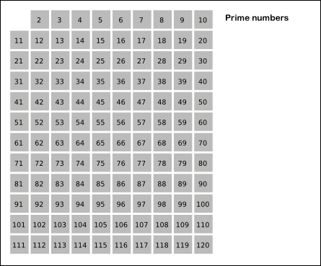
The Sieve of Eratosthenes

Slide 87
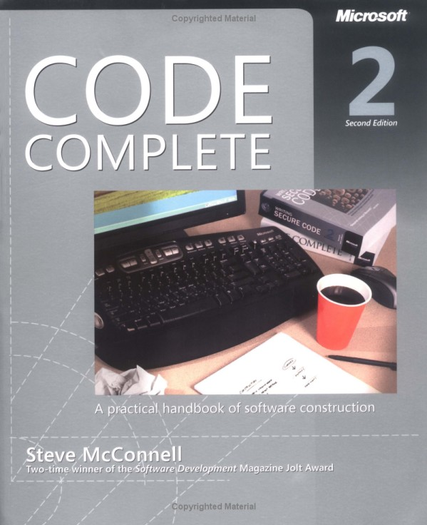

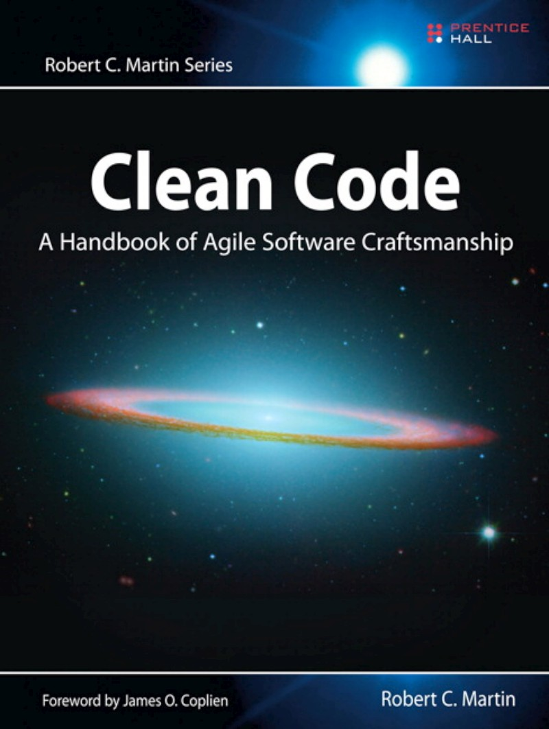
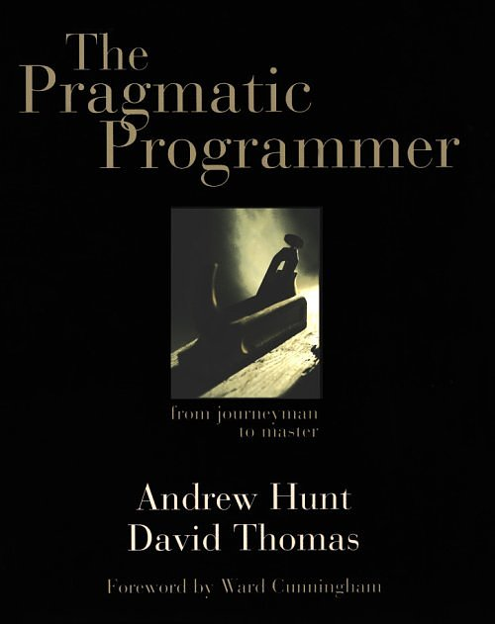
References

Slide 88
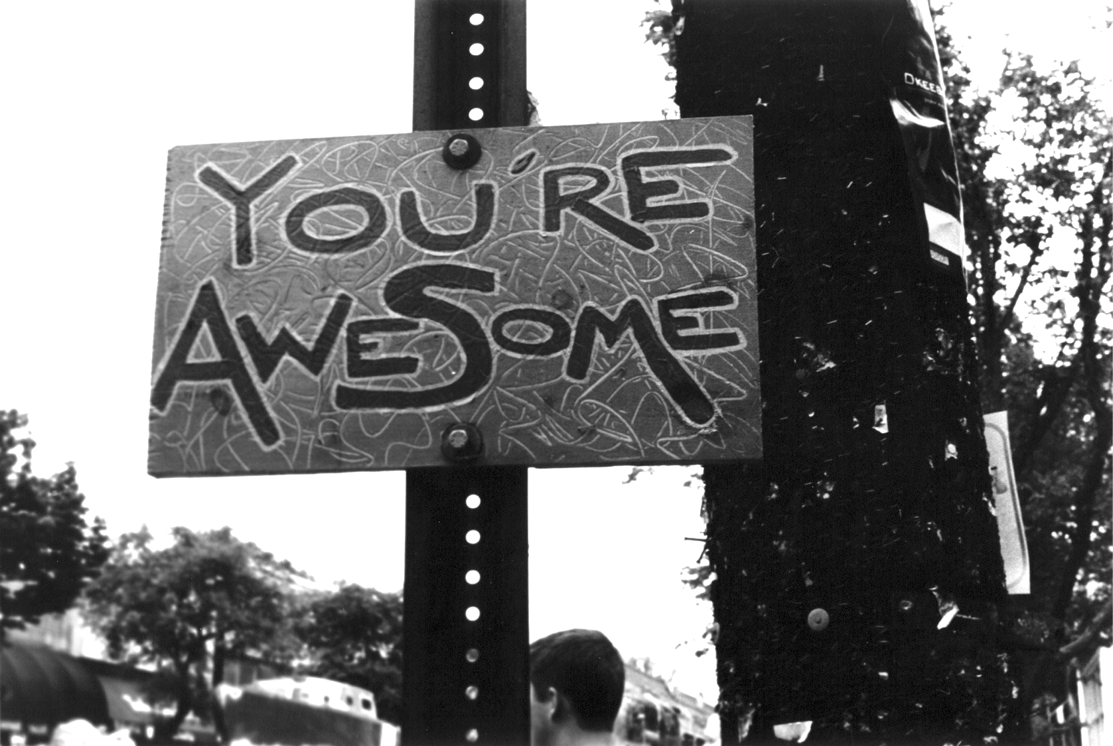

Thank you

